Slide 2
Digital Technology
TK1104
Guest lecturer: Peyman Teymoori
peymant@ifi.uio.no
Lecturer: Toktam Ramezanifarkhani
Toktam.Ramezanifarkhani@kristiania.no
Toktamr@ifi.uio.no

Slide 3
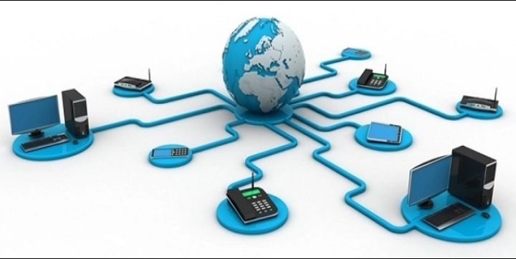
Computer Networks – Link Layer

Slide 4
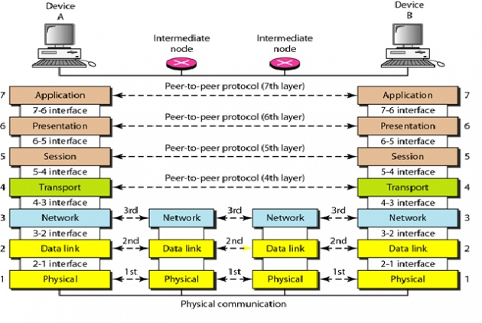
Analogy of Networking
Sender
Receiver
The letter is written, put in an envelope, and dropped in mailbox
The letter is picked up, removed from the envelope, and read.
Higher Layers
The letter is carried from the mailbox to a post office.
Middle Layers
The letter is carried from the the post office to the mailbox.
The letter is delivered to a carrier by the post office
Lower Layers
The letter is delivered from the carrier to the post office.
The parcel is carried from
the source to the destination

Slide 5
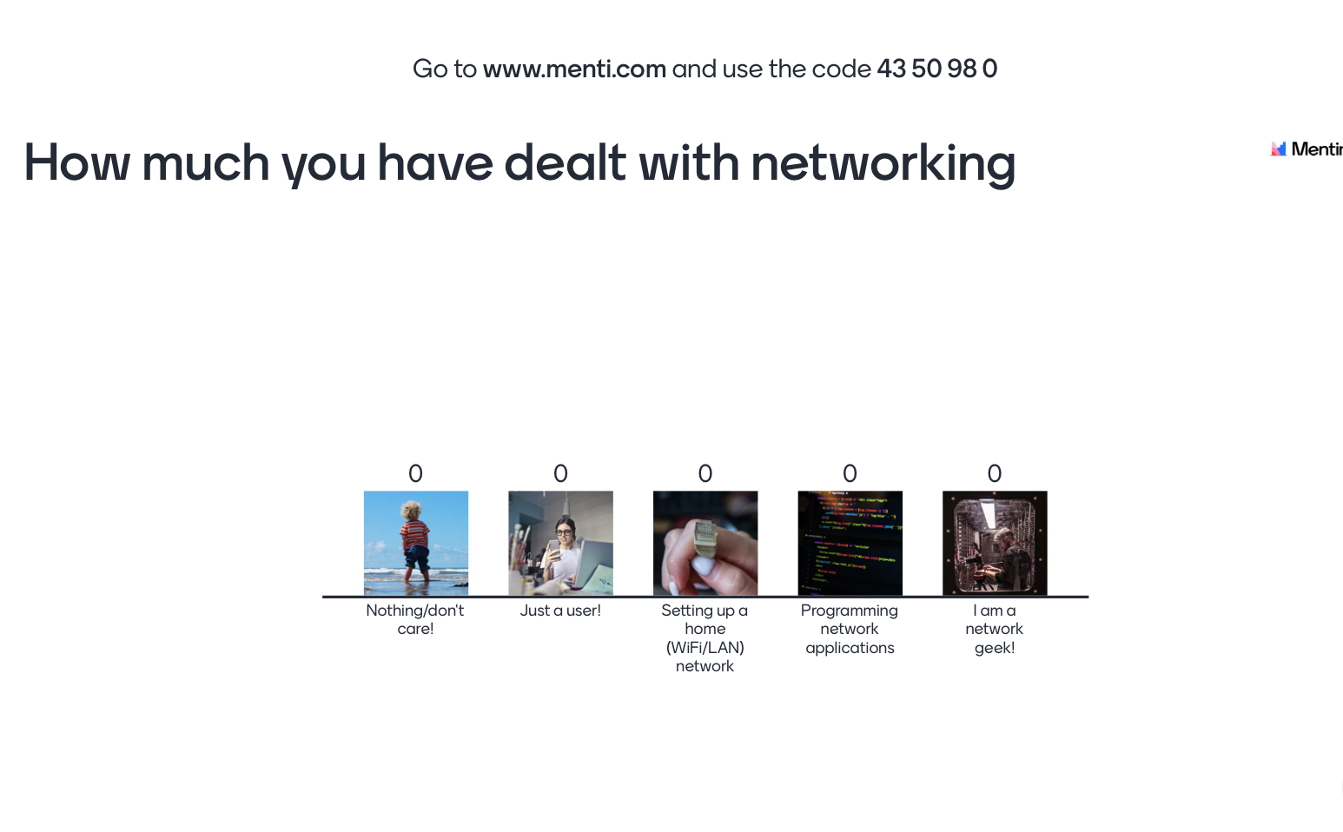
Go to menti.com and use code 3372 9155

Slide 6
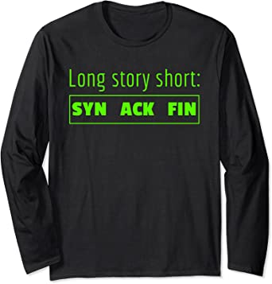
Expectations:
After the lectures, you will be able to
use the TCP/IP model to explain and analyze data communication through the Internet.
use the TCP/IP model and knowledge of protocols belonging to it to analyze the entire process of connecting to a LAN and downloading e.g., a web page.
use standard tools for debugging and correcting network connections.

Slide 7
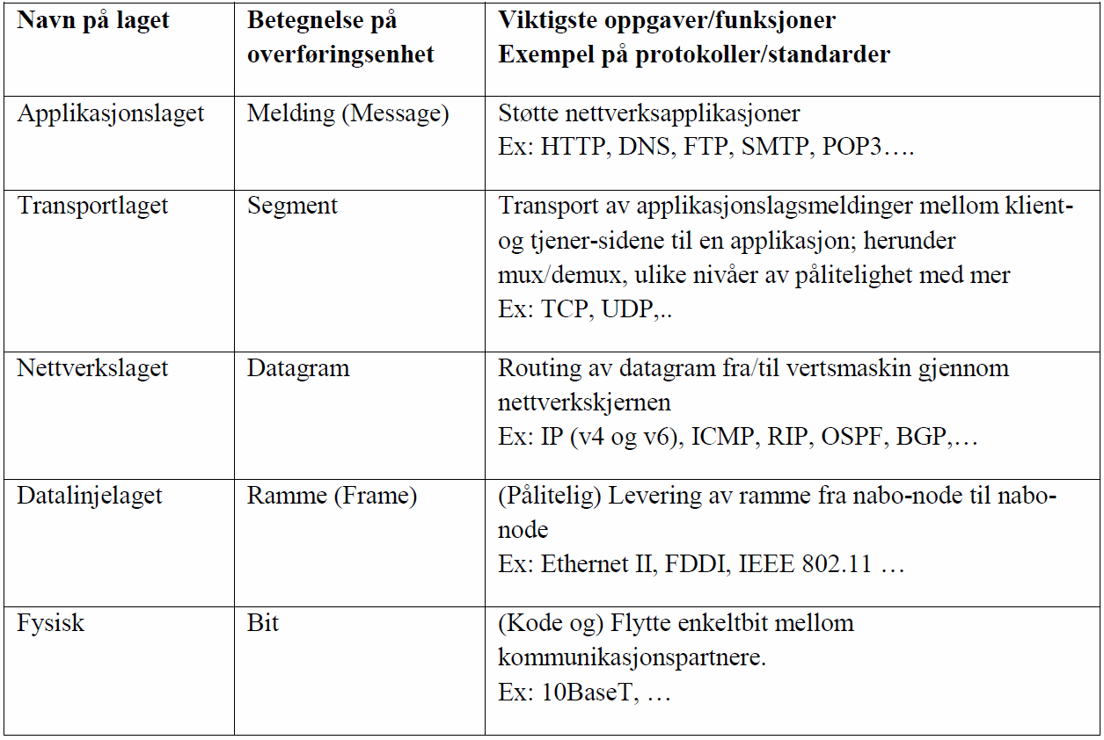
Link layer / Data link layer / Data line layer
Layer´s name
designation of transmission unit
Most important tasks / functions
Example of protocols / standards
Application layer
Mesage
Transport layer
transport of application layer messages between client and server pages of an application: including mux / demux, different levels of reliability and more ..
Ex: TCP, UDP ...
The network layer
routing of datagram from / to host through the network core
Ex: IP (v4 and v6) ICMP, RIP, OSPF, BGP
The data line layer
Frame
(Reliable) delivery of frame from neighbor node to neighbor node.
Ex: Ethernet II, FDDI, IEEE 802.11
Physical
(Code and) Move single bit between communication partners.
Ex: 10BaseT,

Slide 8
Link layer: Introduction
“link”
Some terminology:
Machines, routers and switches are nodes
Communication channels that connect neighboring nodes along the communication path are links.
wired (wired) links
wireless (radio) links
Local Area Network (LAN)
A PDU is called a frame, encapsulating datagrams
Link layer is responsible for transferring
datagrams from one node to another
neighbor node over a link

Slide 9
Link layer services
Framing and link access
Reliable delivery between neighboring nodes
Flow control
Error detection
Error recovery
Half-duplex and full-duplex

Slide 10
Network Interface Cards (NIC) communication
datagram
Link layer protocol
Sender-node
Recipient-node
Frame
Frame
network card
(adapter)
network card
(adapter)
Link layer implemented in network card (NIC)
Ethernet cards, 802.11 cards and so on
Sender side:
encapsulation of datagram in a frame
adds bit for bit error detection, (sequence number, flow control etc.)
Recipient side:
looks for bit errors, re-transmission, flow control etc.
extracts datagram, delivers this to recipient node
NIC is partially autonomous
Modern network adapters often also support transport and network layer functionality

Slide 11
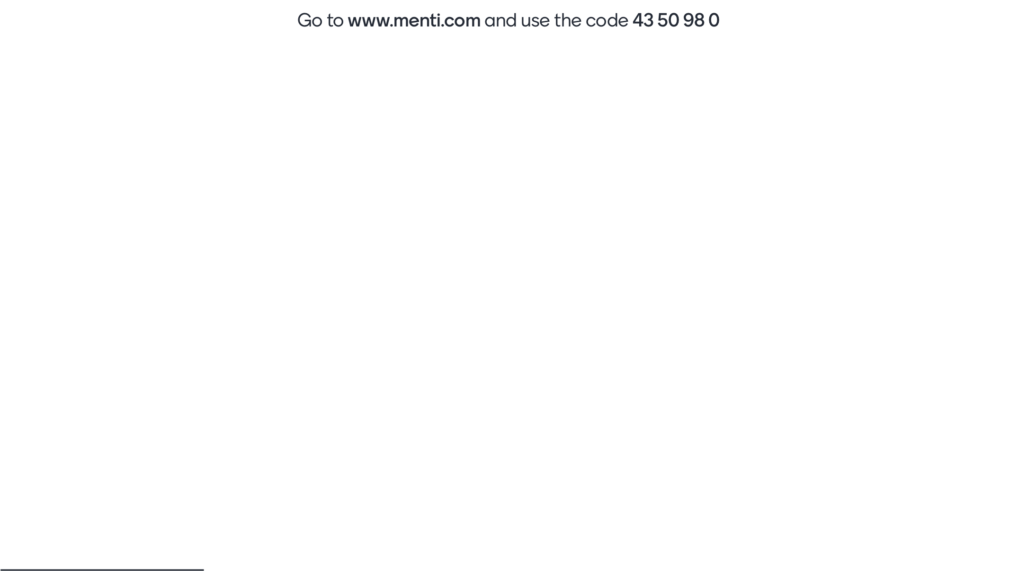
Go to menti.com and use code 3372 9155
Notes:
https://www.mentimeter.com/s/6fc60016b2eac71ff66bf30e4830a835/230493f8e6a0/

Slide 12
Medium Access Control

Slide 13
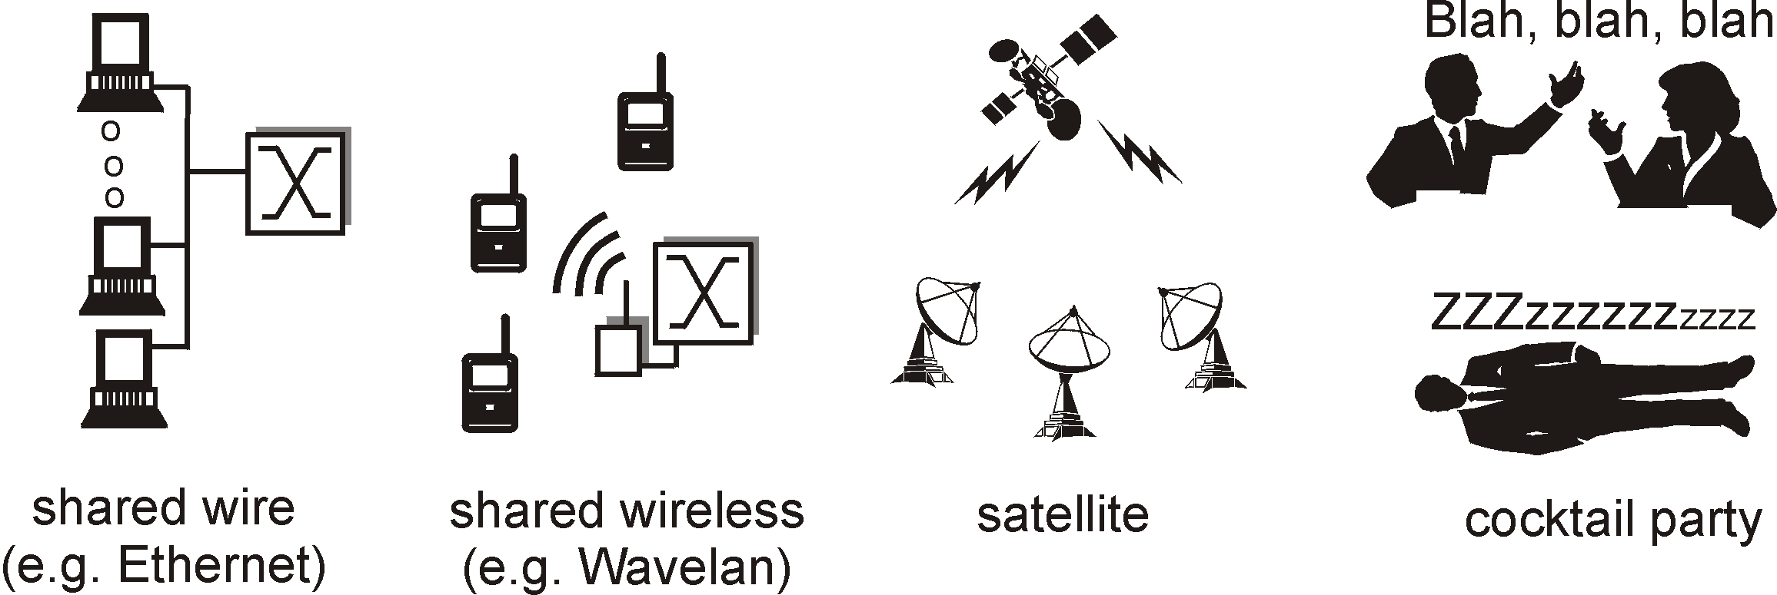
Links and protocols for multiple access
Two main types of "links":
Point to point
PPP for dial-up access
point-to-point link between two routers
broadcast (shared medium).
traditional ethernet
802.11 wireless local area network

Slide 14
MAC protocols: taxonomy
Three different approaches to channel sharing:
Channel partitioning
divides the channel into smaller pieces
Time slots
Frequencies
codes
assigns part of the channel exclusively to a node
Random access
channel is not split, collisions can occur
have methods of handling collisions
Ethernet (IEEE 802.3)
“In Order”
avoids collisions by only allowing one to send at a time
Token Ring (IEEE 802.5)
WiFi (IEEE 802.11 with Access Point)

Slide 15
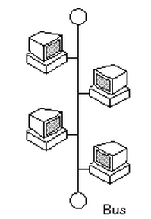
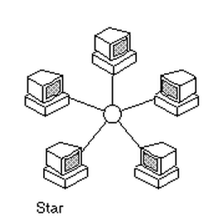
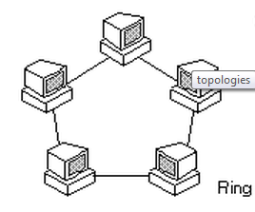
Local Area Network

Slide 16
LAN technologies
Link layer to now:
services, error detection / correction, multiple access
Next: LAN technologies
addressing
Ethernet
hub, switch
PPP

Slide 17
LAN addresses (= MAC addresses)
32-bit IP address:
network layer address
is used to get the datagram from your IP network to the recipient's IP network
MAC (or “LAN” or “Physical” or “Ethernet”) address :
is used to have a frame delivered from one interface to another interface on the same network.
48 bit MAC address (for most LANs) burned into the network card ROM

Slide 18
MAC addresses
Each network card has a "unique" MAC address
Broadcast address are
FF-FF-FF-FF-FF-FF
1A-2F-BB-76-09-AD
Multicast MAC addresses start with 01-00-5E
LAN
(wired/
wireless)
70-65-F7-2B-08-53
58-23-D7-FA-20-B0
= network card
0C-C4-11-6F-E3-98

Slide 19
ARP: Address Resolution Protocol
How to find MAC-
the address of a node that
you know its IP address?
Each IP node (machine and router) on a LAN has one ARP-table / cache
ARP table: IP / MAC address mappings for some LAN nodes
<<IP address; MAC address; TTL>
TTL (Time To Live): the time the mapping should be in the ARP table (typically 20 min)
237.196.7.78
1A-2F-BB-76-09-AD
237.196.7.23
237.196.7.14
LAN
70-65-F7-2B-08-53
58-23-D7-FA-20-B0
0C-C4-11-6F-E3-98
237.196.7.88

Slide 20
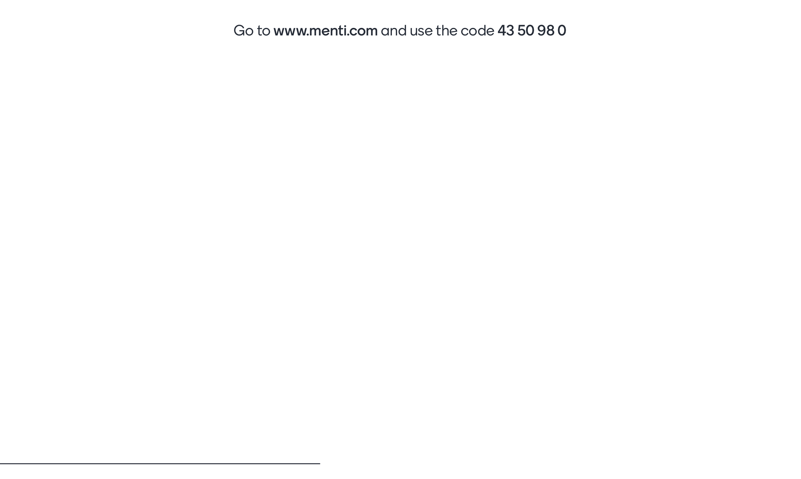
Go to menti.com and use code 3372 9155
Notes:
https://www.mentimeter.com/s/6fc60016b2eac71ff66bf30e4830a835/445584382855/

Slide 21
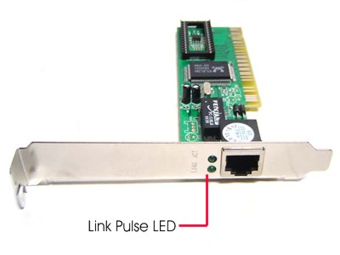
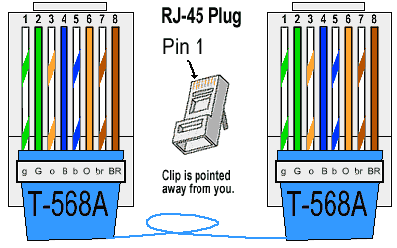
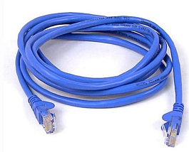
Ethernet

Slide 22
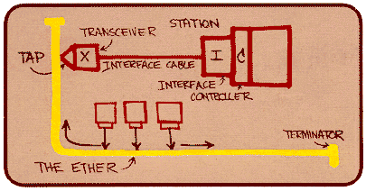
Ethernet
Dominant local network technology:
Cheap
First LAN technology in widespread use
Easier and cheaper than token passing LAN
Has kept pace in the speed race: 10, 100, 1000 Mb / s
Bob Metcalfe’s
Ethernet Sketch

Slide 23
Star topology
Bus topology was popular until the mid-90s
Ethernet is still defined with the assumption of bus topology and how to resolve collisions.
Now it is the star topology that "goes and applies"
Option: (hub or) switch (more later)
hub or
switch

Slide 24
10BaseT and 100BaseT
10/100 Mbps rate; the latter is called “fast ethernet”
1 GbE (1000BASE-T)
Uses all thread pairs, and complicated coding
T stands for “twisted pair”
Nodes associated with a hub: star topology; max distance from node to hub is about 100 m
hub

Slide 25
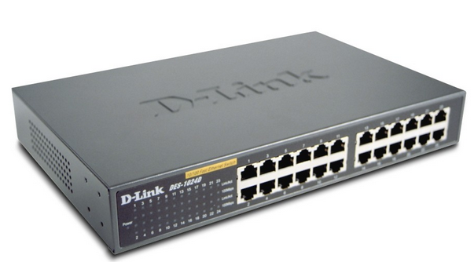
Hub
Hubs are multiport repeaters (physical layer):
bits that come in on a link are sent out on all other links
no buffering of frames
no collision detection in hub: NIC detects any collisions
provides certain network management features
hub

Slide 26
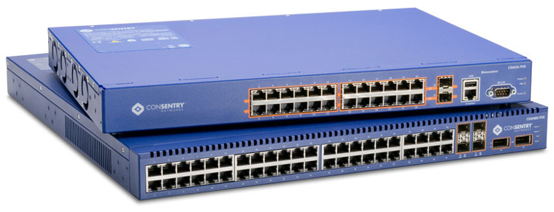
Switch

Slide 27
Coupling with hubs
Spine hub interconnects LAN segments
Extends the maximum distance between nodes
Gives a big collision domain (disadvantage)
Cannot connect 10BaseT and 100BaseT
To connect different physical and layer 2 technologies, you need one bridge
hub
hub
hub
hub

Slide 28
Switch: traffic isolation
installing a switch will divide the local network into segments
Self-learning
Uses Carrier Sense Multiple Access / Collision Detection (CSMA/CD)
the switch filters frames:
frames going to machine on the same segment will not normally be sent to other segments
the segments become separate collision domains
switch
collision domain
hub
hub
hub
collision domain
collision domain

Slide 29
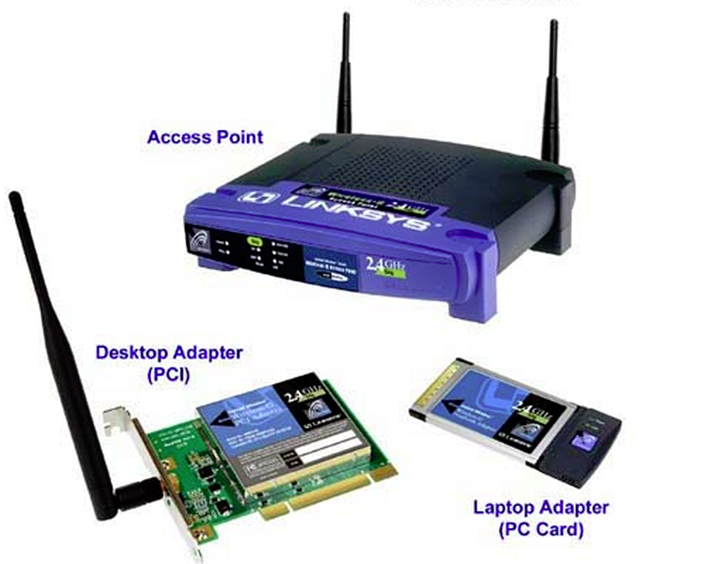
IEEE 802.11

Slide 30
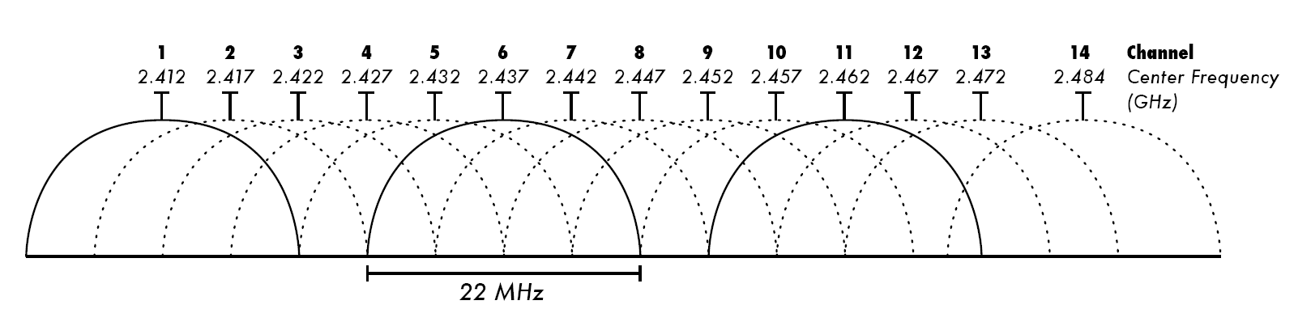
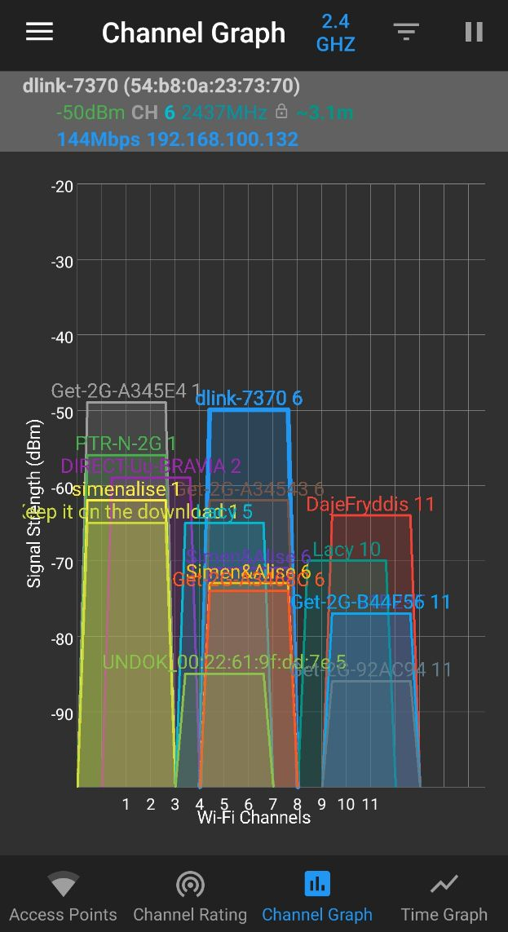
Channels: 1-13, IEEE 802.11 b/g/n Standard
f₃
f₅
f₂
f₄
f₆
f₅
Install the WiFi Analyzer app to see the channels and select a less crowded one!
f₁
f₄
f₃
f₇
f₁
f₂

Slide 31
Signal propagation
Signal propagation in free space is the same as light (straight line)
Received effect proportional with 1/d²
(d = distance between transmitter and receiver)
Received power / signal also affected by
damping (frequency dependent)
obstacles
reflection from major obstacles
refraction depending on the density of the medium
scattering from small obstacles
diffraction on edges (bending of waves)
hinder
reflection
refraction
scattering
diffraction

Slide 32
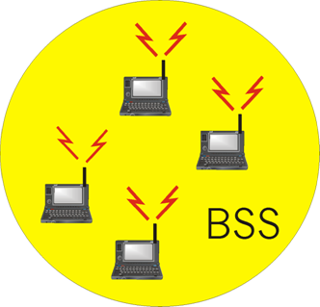
Ad Hoc Network
No AP (i.e., no base station)
Wireless host computers communicate directly and act as switches / routers for each other.
Applications
"Laptop" meetings in the car, at the cabin or similar.
battlefield
Uses Carrier Sense Multiple Access / Collision Avoidance (CSMA/CA)

Slide 33
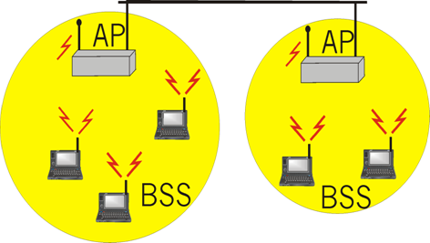
Network with AP
The hosts communicate via a base station
base station = access point (AP)
Basic Service Set (BSS) (corresponds to “cell” in the mobile phone context) consists of :
Wireless hosts
Access Point (AP)
BSSs are combined into one Distribution System (DS) (WLAN)
BSS has an SSID

Slide 34
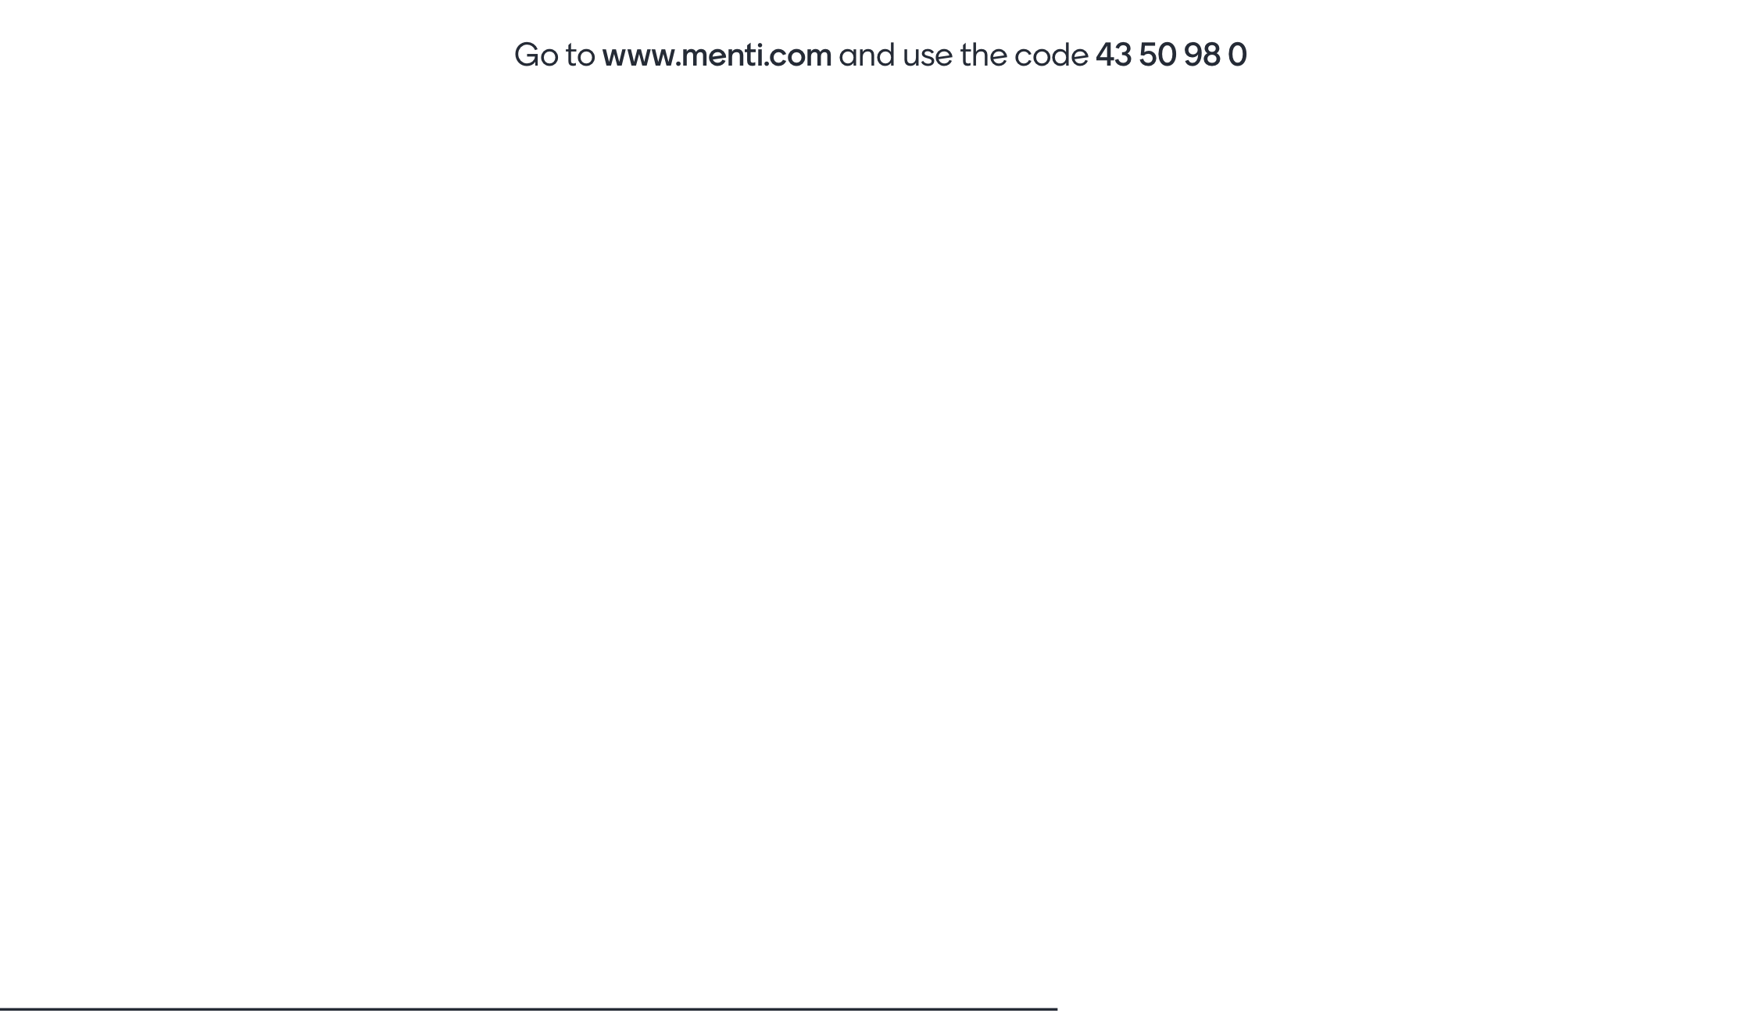
Go to menti.com and use code 3372 9155

Slide 35
END

Slide 36
What should we know?
What tasks are solved on the link layer?
What error detection mechanisms exist and are used?
Calculate parity bits and use 2D parity, calculate CRC
What are the ways to share medium (MA)?
How to avoid or deal with collisions?
MAC-addresses
Structure, multicast, broadcast
IEEE 802.3 / Ethernet 2
Structure of the frame
Know the different types.

Slide 37
What should we know?
Why ARP is needed and how it works.
Including use of the arp command
Know the different LAN topologies
Bus, star, ring
Know the difference hub,bridge,switch and router .
Be able to explain how a switch works
How is the switch table built up?
Be able to explain what new problems need to be solved in wireless networks (IEEE 802.11)
Explain the role of the AP, what is the SSID

Slide 38
About the exam (same we went through earlier)

Slide 39
About the exam
There is a 24-hour deadline for this home exam, but the expected workload is 4-6 hours, so it is not the intention to "work through the night". Please note that the exam MUST be submitted within the set deadline, and must be submitted via the exam platform WISEFLOW. It will not be possible to submit the assignment after the deadline - this means that you should submit in good time so that you can contact the exam office or user support if you have technical problems.
As this is a home exam, it is important to show a holistic understanding, and the assignments have a greater character of discussion. Comprehensive and explanatory answers to all assignments are therefore expected. You can choose to draw figures and sketches in the word processor, or by drawing on paper and uploading a picture - remember to insert the picture in the right place in the answer. (Pictures that are attached but not inserted in the answer are not considered part of the answer.)

Slide 40
About the exam
It is emphasized that the student must answer the exam independently and individually, cooperation between students and plagiarism is not allowed.
In arithmetic problems, it is essential that you emphasize how to arrive at the answer. Answers to arithmetic problems without showing procedures are to be regarded as unanswered problems.
NOTE: The answer should not be more than 15 A4 pages, with font size 12, normal margins and line spacing 1.0.

Slide 41
About the exam
Exercise 1: Theory questions (15%)
Exercise 2: Figures and binary data (35%)
Exercise 3: Practical exercises (30%)
The practical exercises will test your understanding of tools and of protocols, they will not be similar to the ones we have had in the exercises, but the exercises will be very relevant!
Exercise 4: “Heavier” theory and understanding (20%)

Slide 42
Today's rehearsal
Exercises on Canvas
Write down 3 topics that you feel you are struggling with, and that you need to work on more before the exam
Remember the rehearsal lecture the day before the exam!
Complete a previous exam
On Canvas under assignments, I have posted exams from 2020
In a home exam, there will be a little more focus on showing understanding, and a little less pure "cradle" assignments. This year, as you know, there will also be some practical tasks.
Figures and calculations can be drawn on paper, insert the picture in the answer :-)

Slide 43
Examples of practical tasks
Use a standard network tool on the command line and copy the output from the tool in the answer; for example traceroute
Advanced tools:
In this assignment you will demonstrate an understanding of the use of a raw-socket emulator tool such as PuTTY (Windows) or telnet (Linux / OSX), a good understanding of the SMTP protocol is also required to complete this assignment.
You must connect to SMTP on the standard port (Raw connection type), on host send.one.com. You must send an EMAIL from [candidate number] @ h-ck.me to besvarelse@h-ck.me, the email must be entitled «ASSIGNMENT 42» and body «OK».
What response do you get back from this server (provide full response from server)? Explain the procedure you used to solve the problem.

Slide 44
For optional self-study
For those who want to learn some topics more in depth to understand it better, here are some extra topics related to today's teaching, it must be expected some personal work to understand these topics.
There will be no questions on the exam from these, and this is therefore not considered to be part of the syllabus.

Slide 45
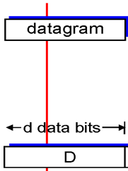
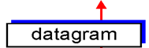
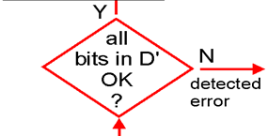


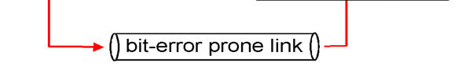
Error detection
D = Data protected by error checks may include header fields
EDC = Error Detection and Correction bits (redundant bit)
Error detection is not 100% reliable
the protocol can overlook errors (although it is rare)
more error detection bits provide better detection and possibility of correction

Slide 46
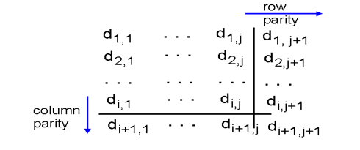
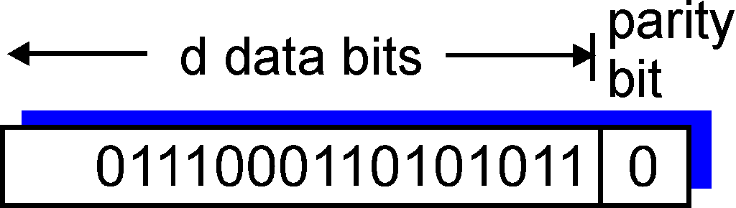
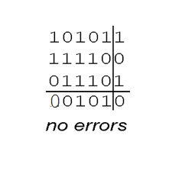
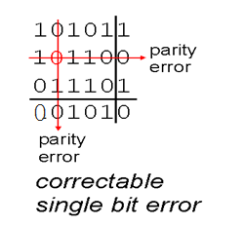
Parity check
One-bit parity:
Can detect if one bit is wrong
Two-dimensional parity bits:
Can detect and correct if one bit is wrong
Equal parity:
The total number of ones (incl. Parity bit) must be an even number
Odd parity:
The total number of units (incl. Parity bit) must be an odd number

Slide 47
Internet checksum (repetition)
Goal: detect bit errors in received segment
Sender:
treats the contents of the segment / datagram as a sequence of 16-bit numbers
checksum: addition (one complement) of the contents of the segment
sender enters checksum into UDP / TCP and IPv4 checksum fields
Recipent:
calculates the checksum of the received segment
see if the calculated checksum is correct:
No ➔ error detected
Yes ➔ no errors detected. But there can still be mistakes…

Slide 48
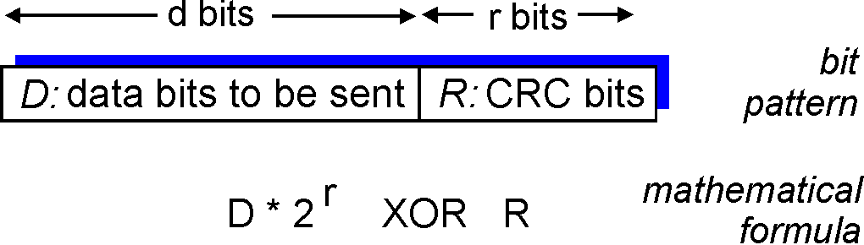
Cyclic redundancy check (CRC)
ser databitene, D, as a binary number
velger et bitmønster, r + 1 bit far ➔ generator, G
goal: choose r CRC-bit, R, so that
DR is divisible by G (modulo 2)
recipient knows G and divides DR with G. If the division gives a residue, there is a bit error
discovers all skur-error less than r + 1 bit
widely used in practice (ATM, HDCL, Ethernet, zip,…)

Slide 49
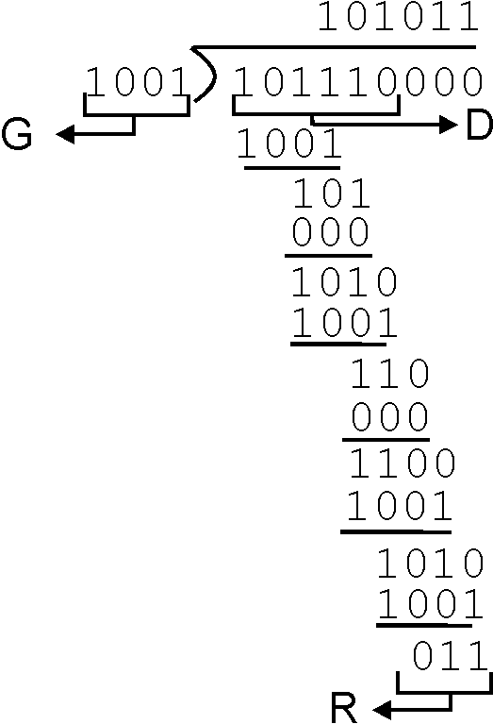
CRC example
Wants:
D . 2^{r} XOR R = nG
equivalent:
D . 2^{r} = nG XOR R
equivalent:
if we divide D. 2r with G is the rest, R, we apply
D . 2^{r}
G
R = rest[ ]

Slide 50
CRC-32
Uses a few different keys
x³² + x²⁶ + x²³ + x²² + x¹⁶ + x¹² + x¹¹ + x¹⁰ + x⁸ + x⁷ + x⁵ + x⁴ + x² + x + 1
Easy to calculate in hardware
XOR ports and shift registers
Detects all burst errors that are 32 bit or less
Detects 1-2-32 = 99.9999999767% of all errors consisting of more than 32 bits
Also used by ZIP, MPEG, PNG, etc.

Slide 51
Link layer: context
Datagram is transmitted by various link protocols over various links:
e.g.
Ethernet on the first link
Frame Relay on the next link
FDDI (fiber) on the next link
…
802.11 on the last link
Each link layer protocol offers different services
eg: one protocol can be reliable, another unreliable
Transport analogy
trip from Halden to Trondheim
train: Halden to Gardermoen
flight: Gardermoen to Værnes
bus: Værnes til Trondheim
travelers = datagram
transport stage = communication link.
Transport type = link layer protocol
travel agency = routing algorithm

Slide 52
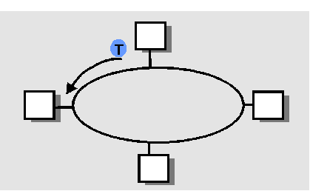
“In turn” MAC protocols
Token passing:
a special frame - token (baton), sent from node to node
token message
cons:
token overhead
latency (delay)
single point of failure (token)
Alternative access options
exist and are used in some places,
e.g. IEEE 802.5
Polling:
master node "invites" slave nodes to send - one at a time
cons:
overhead due to polling
latency - have to wait for turn
single point of failure (master)

Slide 53
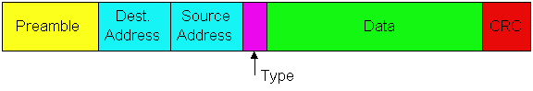
Ethernet frame structure
Network adapter (NIC, adapter) puts the IP datagram (or other layered PDU) into a Ethernet frame
Preamble:
7 octets (7 bytes) with bit pattern 10101010 followed by one octet with bit pattern 10101011
is used to synchronize the receiver's "clock" with the transmitter's

Slide 54
Ethernet frame structure (continued)
Addresses: 6 octets (48 bit)
if the NIC receives a frame with its own address as the destination address or a broadcast frame (eg ARP packet), it delivers data in the frame to the network layer protocol
otherwise it throws the frame
Type: indicates which web layer protocol the data belongs to (normally IP, but also other possibilities, eg Novell IPX or AppleTalk)
CRC: cyclic redundancy check - if an error is detected, the frame is discarded

Slide 55
Ethernet CSMA/CD the algorithm
Web cards get datagrams from web layers and create a frame
2. Sender listens to the media to see if it is available. If no one else is listening, the network card will start sending. If the media is busy, it waits until it becomes available and then sends
3. If the entire frame is sent without a collision, the network card is finished with the frame
4. If the transmitter detects another transmitter at the same time as it, it interrupts the transmission and sends a jam signal instead.
5. After the interruption, the transmitter will make an “exponential backoff”: after collision no. M, the transmitter randomly selects a K from the set {0,1,2,…, 2m-1}. Then it waits K · 512 bit times and returns to step 2.

Slide 56
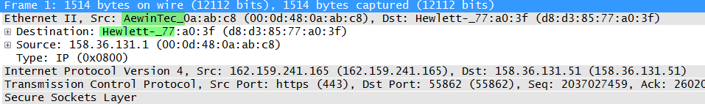
MAC addresses
MAC address assignment is managed by the IEEE
manufacturer buys part of the MAC address space
The first 24 bit tells who is the manufacturer of the network card
Analogy:
(a) MAC-address: personal number
(b) IP-address: postal address
MAC has a "flat" address structure ➔ portability
can easily move a network card from one local area network to another, provided that MAC address filtering is not set up in the AP or switch
IP addresses are hierarchical and therefore not portable
The prefix part of the IP address indicates which network the computer is hanging on

Slide 57
Random access protocols
When a node has packets to send
Transmitter with full channel rate, R
no a priori coordination between the nodes
two or more transmitters simultaneously ➔ “collision”,
random access MAC protocol specifies:
how collisions are detected
how to deal with collisions (e.g. using delayed retransmissions)
Examples of random access MAC protocols:
slotted ALOHA
ALOHA
CSMA, CSMA / CD, CSMA / CA

Slide 58
ARP (Address Resolution Protocol)
A wants to send a datagram to B and knows B's IP address
Assume that B's MAC address is not in A's ARP table
A broadcasts an ARP request that contains B's IP address
all machines on the LAN receive the ARP request
B also receives the ARP packet and answers A with his MAC address
frame is sent directly to A's MAC address
A caches the IP-to-MAC address pair in its ARP table until the information becomes obsolete
“Soft state": information that disappears if it is not refreshed.
ARP is “plug-and-play”:
a node creates its ARP table without the help of anyone

Slide 59
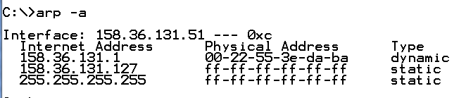
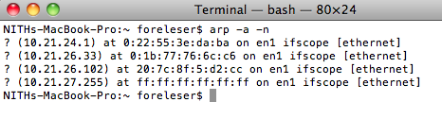
arp
The arp-command can be used to
display ARP cache(-a)
clear ARP cache(-d)
Add fixed IP-MAC connections(-s)

Slide 60
Unreliable, unconnected service
Unconnected : No handshake between sender and receiver
On the other hand, the network cards negotiate which IEEE 802 version and bit rate they will use the first time they are connected.
Unreliable: receiver does not send ACK or NAK back to the transmitter
the flow of datagrams delivered to the web layer may have gaps
if TCP is used, this will fill any gaps
otherwise the application will / must see the gaps in the data stream

Slide 61
Ethernet uses CSMA / CD
No time slots
network card listens online before sending (carrier sense)
does not send if someone else is already sending
the transmitter continues to listen while transmitting and interrupts the transmission if it notices that another is also transmitting (collision detection)
Before the transmitter attempts a retransmission, it waits a randomly selected time(random access)

Slide 62
Ethernet CSMA / CD (continued)
Jam signal: to make sure everyone is aware of the collision; 48 bit
Bit time: 10 ns for 100 Mb / s Ethernet; for K = 1023, consequently, the waiting time will be about 5 ms
Exponential Backoff:
Goal: adapts retransmission attempts to currently estimated load
heavy load: random waiting time often longer
first collision: select K from {0, 1}; latency is K · 512 bit times
after second collision: select K from {0,1,2,3}
after ten collisions: select K from {0, 1, 2, 3, 4,…, 1023}
If still no transmission time: Give up ..

Slide 63
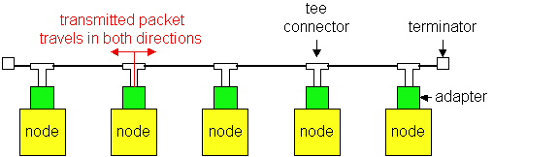
Ethernet technologies: 10Base2
10: 10 Mb/s; Base: baseband; 2: max 200 meters cable
thin coaxial cable in a bus topology
max 30 nodes per segment
repeaters are used to connect several segments
repeater repeats bit it hears on one interface on its other interface: operates on physical layer!

Slide 64
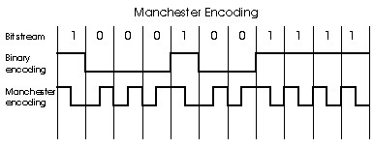
Manchester coding
Used in 10BaseT and 10Base2
Each bit has a transition (low-to-high or high-to-low)
Enables synchronization of transmitter and receiver
receiver must know where each bit starts
no need for centralized, global clock
(This belongs to the physical layer - not the link layer)

Slide 65
Gigabit Ethernet (1000Base-T)
uses standard ethernet frame format
Uses all four wire pairs in the UTP cable
for shared channels, CSMA / CD is used; should have short distances between nodes for peak performance, but can be used up to 100 m
Uses several advanced coding techniques: 5 level pulse amplitude modulation etc.
Full-duplex at 1 Gb / s for point-to-point links
Also available for fiber etc.
10 Gbps exists and is constantly gaining ground
Many different physical standards (PHY)
10GBASE-T for Cat 6, 6A or 7 UTP with RJ45

Slide 66
Switch
Link layer box
caches and forwards Ethernet frames
checks frameheads and forwards when needed– based on the recipient's MAC address
when the frame is to be forwarded on a segment, CSMA / CD is used
transparent
machines are unaware of the presence of the switch
plug-and-play, self-learning
switches do not need to be configured

Slide 67
Forwarding
spine switch
1
2
3
spread switch
How to decide which LAN segment the frame should be sent to?
Looks like a routing issue ..

Slide 68
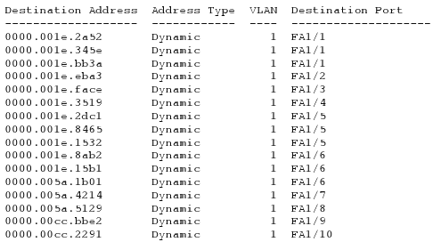
Self-learning
A switch has a switch-table
rows in the switch table :
(MAC address, interface, timestamp)
obsolete elements in the table are deleted (TTL can be 60 min)
The switch learns which machines can be accessed on the various interfaces
when it receives a frame, the switch will "remember" which segment the frame came from combined with the sender's MAC address
saves this in its switch table

Slide 69
Switches: dedicated access
Switch with many interfaces
Machines have a direct connection to the switch
No collisions, full duplex
Switching : A-to-A 'and B-to-B' at the same time, no collisions
A
C’
B
switch
C
B’
A’

Slide 70
Network for an institution
mail server
to external
net
router
web server
switch
IP subnett
switch

Slide 71
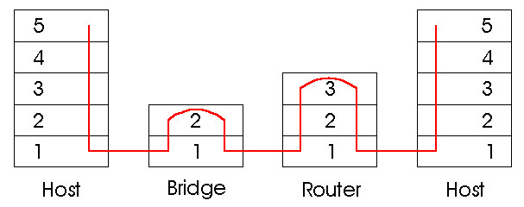
Switches vs. routers
both are "store-and-forward" devices
routers: layer layer devices (looks at layer layer headers)
switches are link layer devices
routers use routing tables and implement routing algorithms
switches use switch tables, do filtering, and have self-learning
Host
switch
Router
Host

Slide 72
Comparison - summary
72/89
hub
router
switch
Traffic
- isolation
no
yes
yes
yes
no
yes
optimal routing
no
yes
no
yes
no
yes

Slide 73
VLAN: motivation
What happens if: Adm user changes office to Fagstab corridor, but will continue to hang on Adm switch?
A single broadcast domain:
all layer-2 broadcast traffic (ARP, DHCP) is sent to the entire LAN (security / privacy, inefficient
The spreading switches use only a few of their ports.
What's wrong with this LAN?
Administration
Students
Professional staff

Slide 74

Virtual LAN
Port-based VLAN: switch ports are grouped (with switch management software) such a single physical switch ……
Virtual Local
Area Network
Switch (s) that support VLAN can be configured to define more virtual LAN in a simple physical LAN.
1
7
9
15
2
8
10
16
…
…
Administration
(VLAN ports 1-8)
Professional staff
(VLAN ports 9-15)
… Acts as multiple virtual switches
1
7
9
15
2
8
10
16
…
…
Administration (VLAN ports 1-8)
Professional staff
(VLAN ports 9-16)

Slide 75
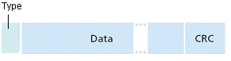
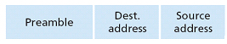
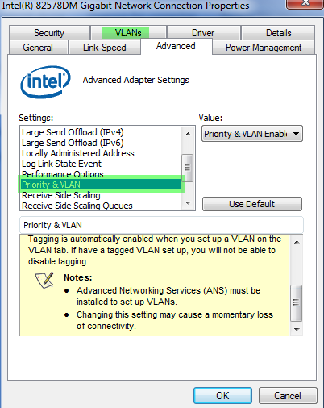
75/89
802.1Q VLAN frame format
Type
802.3 frame
802.1Q frame
2-byte Tag Protocol ID
(value: 81-00)
Converted
CRC
Tag Control Information (12 bit VLAN ID field,
3 bit priority field, cf. IP TOS)

Slide 76
IEEE 802.11 Wireless LAN (Wi-Fi)
Everyone uses CSMA/CA for access
All offer both base station (AP) and ad-hoc network versions
802.11a
5-6 GHz
up to 54 Mbps
OFDN
802.11g
2.4 GHz range
Up to 54 Mbps
802.11n
2.4 and / or the 5 GHz range
Up to 150 Mbps
Range 70/250 m
Multiple (4) antennas (MIMO)
Forward Error Correction
802.11b
2.4 GHz license-free radio waveband
up to 11 Mbps
direct sequence spread spectrum (DSSS) in physical layer
Similar to CDMA, but all hosts use the same "chipping code"
Range 38/140 m
Begins to be phased out in favor of g and n; but most wireless cards still support it.

Slide 77
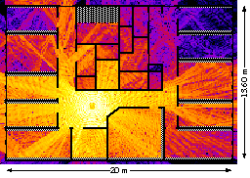
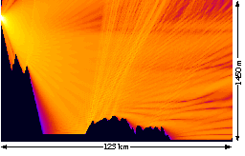
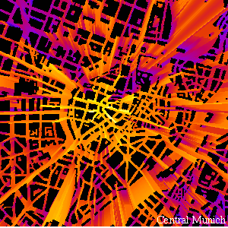
Example: radio radiation / intensity

Slide 78
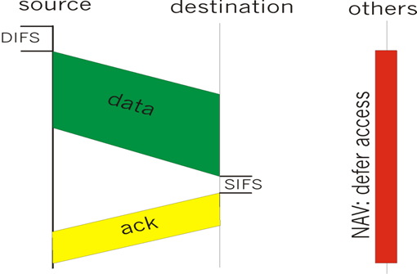
IEEE 802.11 MAC Protocol: CSMA/CA
802.11 CSMA: transmitter
- if sense channel available for DISF seconds.
then transmit entire frame (no collision detection)
-if sense channel busy then binary backoff
802.11 CSMA receiver
- if received OK
send ACK after SIFS
(ACK required due to "hidden nodes issue")
DIFS = Distributed Inter Frame Spacing SIFS = Short Inter Frame Spacing

Slide 79
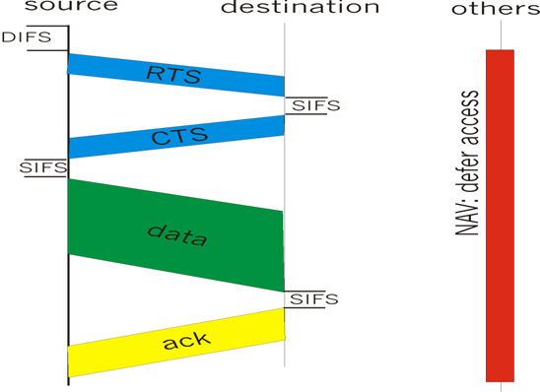
RTS-CTS exchange
Sender transmits card RTS (request to send) packet: indicates the duration of the transmission
Recipient responds with short CTS (clear to send) package
alerts (possibly hidden) other nodes
Hidden nodes then refrain from sending in the reserved time: NAV

Slide 80
Different CAs
IEEE 802.11 thus allows:
"Pure" CSMA
CSMA / CA
Reservations
Polling from AP
AP assigns time to each node on loop (RR)

Slide 81
802.11 frame: addressing
2
2
6
6
6
2
6
0 - 2312
4
frame
control
duration
address
1
address
2
address
3
seq
control
address
4
payload
CRC
Address 3: used only in ad hoc mode
Address 1: MAC address
to host or AP
which will receive the frame
Address 3: MAC address
to the router interface to which the AP is connected
Address 2: MAC address
to host or AP
which sends the frame

Slide 82
82/89
802.11 frame: addressing
Internet
H1
R1
router
AP
R1 MAC addr AP MAC addr
dest. address
source address
802.3 frame
AP MAC addr H1 MAC addr R1 MAC addr
address 1
address 2
address 3
802.11 frame

Slide 83
83/89
802.11 frame: more
frame seq #
(for reliable ARQ)
duration reserved
transmission time (RTS / CTS)
2
2
6
6
6
2
6
0 - 2312
4
frame
control
duration
address
1
address
2
address
3
seq
control
address
4
payload
CRC
2
2
4
1
1
1
1
1
1
1
1
Protocol
version
Type
Subtype
To
AP
From
AP
More
frag
Retry
Power
mgt
More
data
WEP
Rsvd
frame type
(RTS, CTS, ACK, data)

Slide 84


Wireless LAN: Problem -> CA.
If two terminals are "hidden" from each other, collisions can occur
Collision Detection is thus not sufficient
Uses CSMA/CA (Collision Avoidance)
Can use Request-To-Send and Clear-To-Send signals to reserve connection

Slide 85
Collision Avoidance
Problem:
Two nodes, which are hidden from each other, send complete packets to the base station where they interfere and are lost.
Wasted bandwidth for everyone!
Solution:
Small reservation packages!
The nodes keep track of reserved time with their own “network allocation vector” (NAV)

Slide 86
802.11 Security & WiFi
Goal
Access control
Only those who are given access will get it
DataIntegritet
No one should be able to change the contents of the data packets during transmission ("man in the middle attacks")
Confidentiality
Prevent eavesdropping and session hijacking
Method
Encryption of the traffic between AP and user machine
Techniques
WEP
Easy to crack due to repetitive 40 bit keys etc.; better with 128 bit key but still easy to crack
Static key
WPA 1 & 2
New encryption key for each package = better encryption
WPA 1 can crack,
WPA 2 can also be cracked
WPA 2 also allows you to use authentication server (more secure a PSK = common password))
CCMP encryption is stronger than TKIP.
EAP (Extensible Authentication Protocol)
Will make various WPA-Enterprise methods interoperable.

Slide 87
How to secure your own wireless network
Do not use default settings against your own WLAN / ISP
Update firmware on AP and drivers for WNIC (minimum annually)
Turn off "Remote Administration" on the AP
Choose complicated / secure Admin password
Select "unusual" IP network
preferably from the 172.16.0.0/12 area
limit DHCP pool
Filter access to MAC addresses
Turn off SSID broadcast
Be sure to check the range of the signal!
Use WPA2 with a long and complicated password

